Slide 1


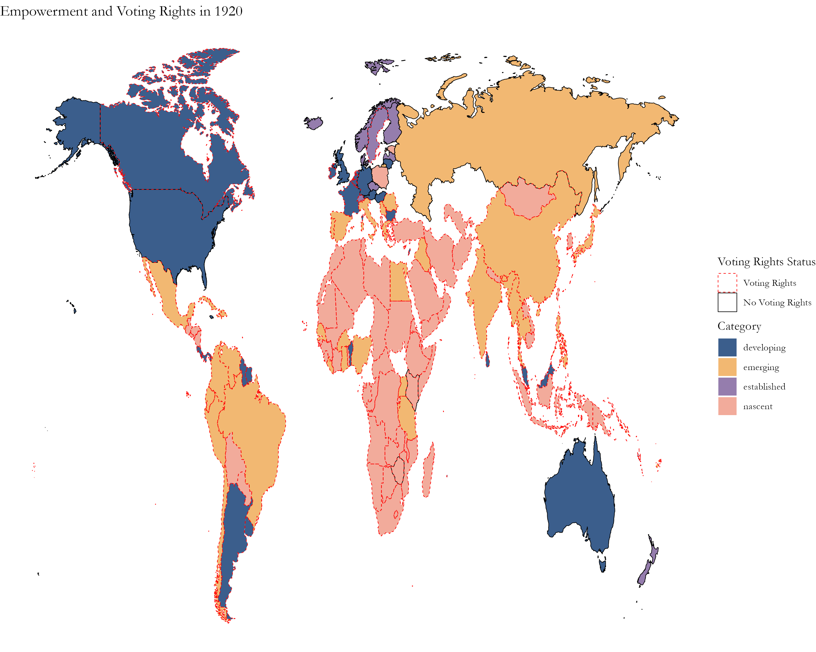
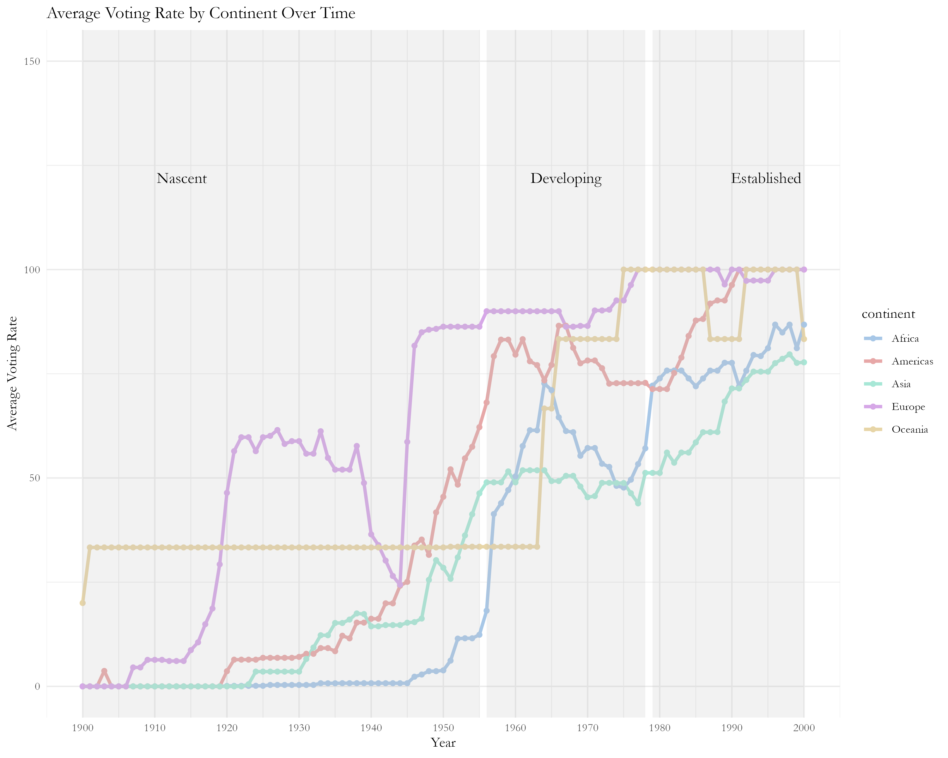

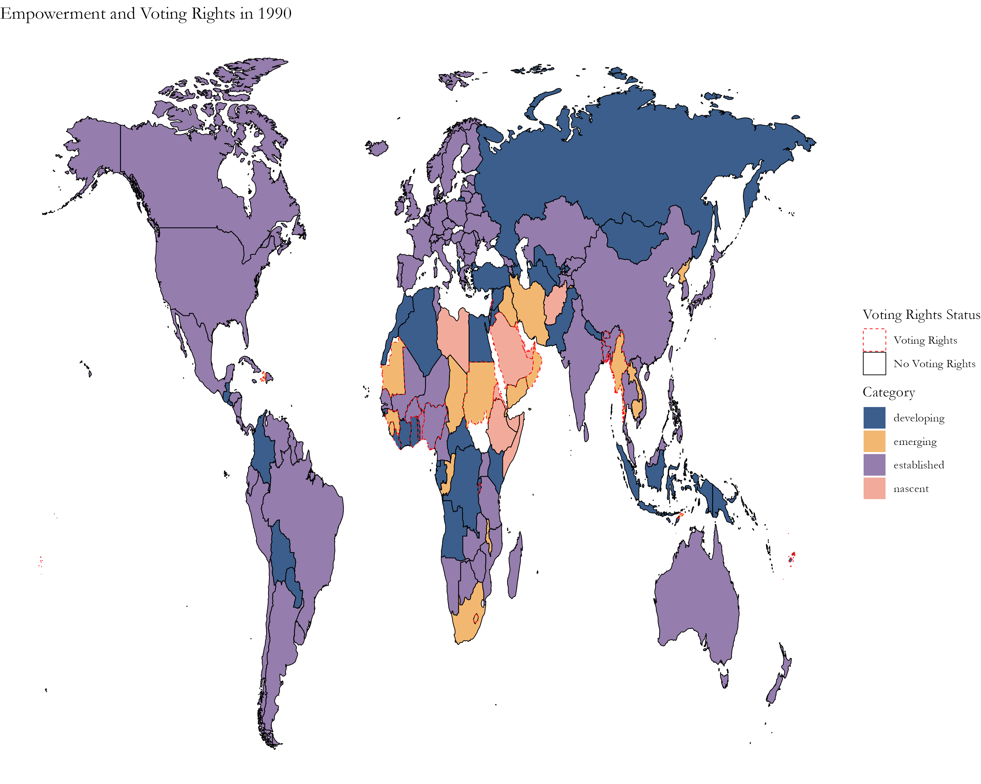
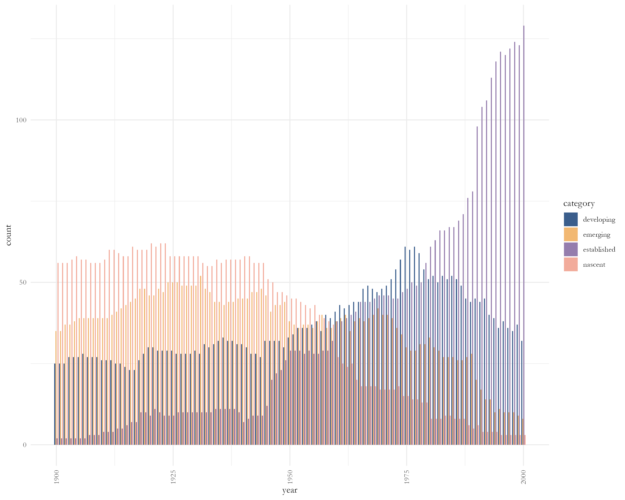
Tracking Women’s Political Empowerment and Suffrage (1900 -2000)
Athena B. Rodrigues
The George Washington University Department of Data Science
Undergraduate Capstone, Spring 2024
Introduction
Methodology
The Women’s Political Empowerment Index combines information from three calculated indices about women’s political and civil society progress and combines them into one index that measures overall political empowerment. With data spanning over 100 years (1900-2012), an index of three varieties, and over 170 countries, this index provides the most comprehensive and best-covering measure of empowerment by considering newly formed countries, shifting central concepts of women’s rights, and providing a better representation of the Global South.
Empowerment Categories
The split points are the points in the WPEI where the data can be broken into similar groups. The Quantile Method was used to split the data into four categories providing a broader understanding of empowerment preventing the deflation of newly formed and inflation of existing countries.
Category | Range
Nascent | WPEI < 0.188
Emerging | 0.188 < WPEI < 0.336
Developing | 0.335 < WPEI < 0.546
Established | WPEI > 0.546
Women’s
Civil Liberties
Index
Freedom of domestic movement for women
Freedom from forced labor for women
Property rights for women
Access to justice for women
Women’s
Civil Society
Participation
Index
Freedom of discussion for women
Women’s Participation in Civil Service Organizations
Percentage of female journalists
Shiny App QR Code
Empowerment Periods
An Empowerment Period contains each category’s dominant years for the 20th century. This was found using two methods: graph visuals and threshold calculations. The emergent category was dropped for finding Empowerment Periods due to large overlaps, it was kept in for all other parts.
Women’s
Political Participation
Index
Power distribution by gender
Political position representation
Presence of women in legislature
Women’s
Political Empowerment
Index
Period | Years
Nascent | 1900 – 1955
Developing | 1956 – 1978
Established | 1979 - 2000
Research Questions
1.
Can women's political empowerment be categorized and reflect the changes in nation-state building, modernization, and gender equality over the 20th Century?
2.
What trends emerge from the mapping of these categories and how do changes in women's suffrage influence these categorizations?
3.
Does this mapping method showcase regional patterns in women's political empowerment or suffrage?
90%
80%
75%
Nascent | 1900 | 1944 | 1900 | 1946 | 1900 | 1948
Emerging | 1918 | 1944 | 1914 | 1969 | 1905 | 1972
Developing | 1974 | 1978 | 1867 | 1987 | 1966 | 1987
Established | 1994 | 2000 | 1991 | 2000 | 1990 | 2000
Data Source
Sundström, A., Paxton, P., Wang, Y. T., & Lindberg, S. I. (2017). Women’s political empowerment: A new global index, 1900–2012. World Development, 94, 321-335.

Slide 2
Tracking Women’s Political Empowerment and Suffrage (1900 -2000)
Athena B. Rodrigues
Undergraduate Capstone Spring 2024
Background
Methodology
Women’s
Civil Liberties
Index
Freedom of domestic movement
Freedom from forced labor
Property rights
Access to justice
Empowerment Categories
Category | Range
Nascent | WPEI < 0.188
Emerging | 0.188 < WPEI < 0.336
Developing | 0.335 < WPEI < 0.546
Established | WPEI > 0.546
Women’s
Civil Society
Participation
Index
Freedom of discussion
Participation in Civil Service Organizations
Percentage of female journalists
Empowerment Periods
Women’s
Political Participation
Index
Power distribution by gender
Political position representation
Presence in Legislature
Period | Years
Nascent | 1900 – 1955
Developing | 1956 – 1978
Established | 1979 - 2000
Empowerment through the Decades
Women’s
Political Empowerment
Index
A measurement which…
considers new countries
adjusts with central concepts of women’s rights
gives a better representation of the Global South.
Research Questions
1.
Can Empowerment be Categorized and Reflect the Development of the 20th Century?
2.
How does Suffrage Impact Empowerment?
Empowerment Period Thresholds
Start
90%
End
Start
80%
End
Start
75%
End
3.
Are there Regional Patterns in Empowerment or Suffrage?
Nascent | 1900 | 1944 | 1900 | 1946 | 1900 | 1948
Emerging | 1918 | 1944 | 1914 | 1969 | 1905 | 1972
Developing | 1974 | 1978 | 1867 | 1987 | 1966 | 1987
Established | 1994 | 2000 | 1991 | 2000 | 1990 | 2000
Reference
Sundström, A., Paxton, P., Wang, Y. T., & Lindberg, S. I. (2017). Women’s political empowerment: A new global index, 1900–2012. World Development, 94, 321-335.
*Emerging Period condensed due to overlap

